Slide 1
Individual differences
Dr Vibhav Singh
School of Business Management

Slide 2
Individual differences
Individual differences have a direct effect on behavior
 People who perceive things differently behave differently
 People with different attitudes respond differently to directives
 People with different personalities interact differently with bosses, coworkers, subordinates, and customers

Slide 3
Individual differences
Individual differences help explain: explain:
 Why some people embrace change and others are fearful of it and others are fearful of it
 Why some employees will be productive only if they are closely supervised, while others will be supervised, while others will be productive if they are not productive if they are not
 Why some workers learn new tasks more effectively than others more effectively than other

Slide 4
Describe Personality, the Way It Is Measured, and the Factors that Shape It (1 of 4)
Defining Personality
Personality is a dynamic concept describing the growth and development of a person’s whole psychological system.
The sum of ways in which an individual reacts to and interacts with others.
Notes:
We begin by defining personality. Personality is a dynamic concept, meaning it is changing all the time. It describes the total of growth and development of a person’s whole psychological system. The text definition is that personality is the sum of ways in which an individual reacts to and interacts with others.

Slide 5
Describe Personality, the Way It Is Measured, and the Factors that Shape It (2 of 4)
Measuring Personality
Managers need to know how to measure personality.
Personality tests are useful in hiring decisions and help managers forecast who is best for a job.
The most common means of measuring personality is through self-report surveys.
Notes:
One of the greatest challenges in the study of personality is its measurement. Managers need to know how to measure personality because accurately measuring personality gives managers an advantage in the recruitment and hiring processes. Typically, personality is measured using self-report surveys.
Research indicates our culture influences the way we rate ourselves. People in individualistic countries trend toward self-enhancement, while people in collectivist countries such as Taiwan, China, and South Korea trend toward self-diminishment.
Observer-ratings surveys provide an independent assessment of personality. Here, a coworker or another observer does the rating.
Though the results of self-reports and observer-ratings surveys are strongly correlated, research suggests observer-ratings surveys predict job success more than self-ratings alone.
However, each can tell us something unique about an individual’s behavior, so a combination of self-reports and observer reports predicts performance better than any one type of information.

Slide 6
Describe Personality, the Way It Is Measured, and the Factors that Shape It (3 of 4)
Personality Determinants
Is personality the result of heredity or environment?
Heredity refers to those factors that were determined at conception.
The heredity approach argues that the ultimate explanation of an individual’s personality is the molecular structure of the genes, located in the chromosomes.
Notes:
An early argument centered on whether or not personality was the result of heredity or environment. Personality appears to be a result of both influences. Heredity refers to those factors that were determined at conception. The heredity approach argues that the ultimate explanation of an individual’s personality is the molecular structure of the genes, located in the chromosomes.

Slide 7
Describe Personality, the Way It Is Measured, and the Factors that Shape It (4 of 4)
Early research tried to identify and label enduring personality characteristics.
Shy, aggressive, submissive, lazy, ambitious, loyal, and timid.
These are personality traits.
Notes:
Popular characteristics include shy, aggressive, submissive, lazy, ambitious, loyal, and timid. These are personality traits. The more consistent the characteristic over time, and the more frequently it occurs in diverse situations, the more important the trait is in describing the individual.

Slide 8
Strengths and Weakness of the MBTI and Big Five Model (1 of 7)
The most widely used personality framework is the Myers-Briggs Type Indicator (MBTI).
Individuals are classified as:
Extroverted or Introverted (E or I)
Sensing or Intuitive (S or N)
Thinking or Feeling (T or F)
Perceiving or Judging (P or J)
INTJs are visionaries.
ESTJs are organizers.
ENTPs are conceptualizers.
Notes:
The most widely used personality framework is the Myers-Briggs Type Indicator (MBTI). Individuals are classified as Extroverted or Introverted (E or I), Sensing or Intuitive (S or N), Thinking or Feeling (T or F), and Perceiving or Judging (P or J). These classifications are then combined into 16 personality types.
INTJs are visionaries. They usually have original minds and great drive. They are characterized as skeptical, critical, independent, determined, and often stubborn.
ESTJs are organizers. They are realistic, logical, analytical, decisive, and have a natural head for business or mechanics.
ENTPs are conceptualizers. They are innovative, individualistic, versatile, and attracted to entrepreneurial ideas. They tend to be resourceful in solving challenging problems but may neglect routine assignments.
MBTI is widely used. It is taken by over 2.5 million people each year and 89 of the Fortune 100 companies use it.

Slide 9
Strengths and Weakness of the MBTI and Big Five Model (2 of 7)
The Big Five Model
Extraversion
Agreeableness
Conscientiousness
Emotional stability
Openness to experience
Notes:
An impressive body of research supports that five basic dimensions underlie all other personality dimensions. The five basic dimensions are extraversion, agreeableness, conscientiousness, emotional stability, and openness to experience. Let’s look at each of these for a minute.
Extraversion is a comfort level with relationships. Extroverts tend to be gregarious, assertive, and sociable. Introverts tend to be reserved, timid, and quiet.
Agreeableness is an Individual’s propensity to defer to others. People who are high on agreeableness are cooperative, warm, and trusting. Low agreeableness is indicated by people who are cold, disagreeable, and antagonistic.
Conscientiousness is a measure of reliability. A highly conscientious person is responsible, organized, dependable, and persistent. Those who score low on this dimension are easily distracted, disorganized, and unreliable.
Emotional stability describes a person’s ability to withstand stress. People with positive emotional stability tend to be calm, self-confident, and secure. Those with high negative scores tend to be nervous, anxious, depressed, and insecure.
And lastly, openness to experience suggests the range of interests and fascination with novelty. Extremely open people are creative, curious, and artistically sensitive. Those at the other end of the openness category are conventional and find comfort in the familiar.

Slide 10
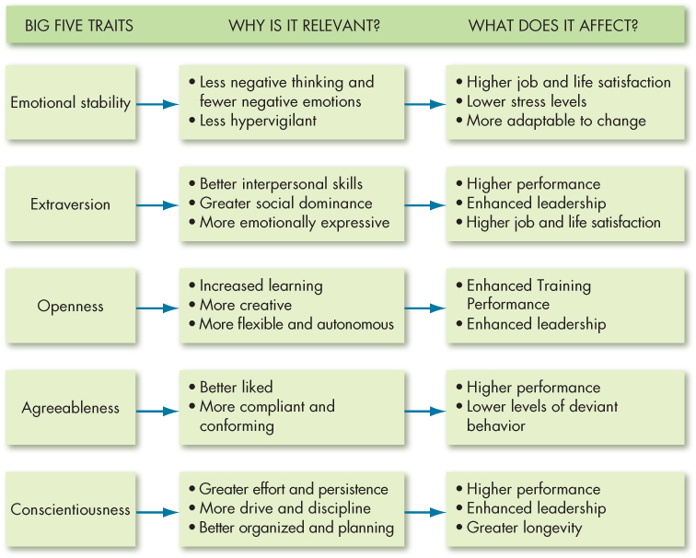
Strengths and Weakness of the MBTI and Big Five Model (4 of 7)
Exhibit 5-2 Model of How Big Five Traits Influence OB Criteria
Notes:
All five traits also have other implications for work and for life. Let’s look at these one at a time. Exhibit 5-2 summarizes the points.
Of the Big Five traits, emotional stability is most strongly related to life satisfaction, job satisfaction, and reduced intentions to quit and burnout.
People with high emotional stability can adapt to unexpected or changing demands in the workplace.
Extraversion is a relatively strong predictor of leadership emergence and behaviors in groups. Extraverts also tend to have generally high job satisfaction and reduced burnout. Some negatives are that extraverts can appear to be self-aggrandizing, egoistic, or too dominating and that their social behavior can be disadvantageous for jobs that do not require frequent social interaction.
Individuals who score high on openness to experience are more likely to be effective leaders and are more comfortable with ambiguity. They cope better with organizational change and are more adaptable in changing contexts.
Agreeable individuals are better liked than disagreeable people, which explains why they should perform well in interpersonally oriented jobs such as customer service.
They experience less work–family conflict and are less likely to turnover. People who are agreeable are more satisfied in their jobs and contribute to organizational performance by engaging in citizenship behavior. They are also less likely to engage in organizational deviance.
One downside is that agreeableness is associated with lower levels of career success.
The five personality factors identified in the Big Five model appear in almost all cross-cultural studies.
These studies have included a wide variety of diverse cultures such as China, Israel, Germany, Japan, Spain, Nigeria, Norway, Pakistan, and the United States. Generally, the findings corroborate what has been found in U.S. research: of the Big Five traits, conscientiousness is the best predictor of job performance.

Slide 11
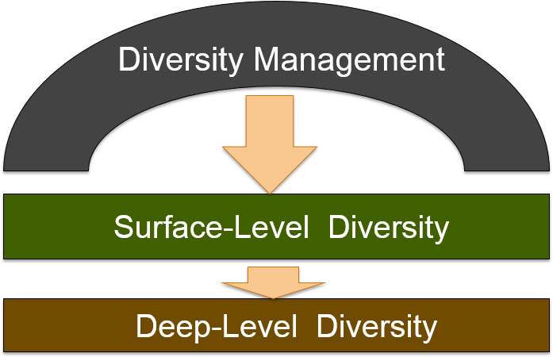
Workplace Diversity
Notes:
Everyone brings differences to the organizations where they work. These differences can create energy and excitement in the workplace, but they can also cause conflict. So, it is important that we have an understanding of how diversity works in organizations.
When we look at the workplace, we recognize two levels of diversity. Surface-level diversity represents the characteristics that are easily observed such as race, gender, and age. Deep-level diversity represents the aspects that are more difficult to see at first glance such as values, personality, and work preferences.

Slide 12
Workplace Discrimination and Organizational Effectiveness (1 of 3)
Discrimination is to note a difference between things.
Unfair discrimination assumes stereotypes about groups.
Refusal to recognize individual differences is harmful to organizations and employees.
Stereotype threat describes the degree to which we agree internally with the generally negative stereotyped perceptions of our groups.
Can be combatted by treating employees as individuals and not highlighting group differences.
Notes:
Managing diversity effectively requires working to eliminate unfair discrimination. The act of discrimination means to note differences between things, which isn’t a bad thing. However, when we allow our behavior to be influenced by stereotypes about groups of people, unfair discrimination can be harmful to organizations and employees. Recognizing people for their abilities rather than assumptions of stereotypes is an important part of OB and its application to the work environment.
Stereotype threat has serious implications for the workplace. Stereotype threat can occur during preemployment tests and assessments, performance evaluations, and everyday workplace exchanges. It can lead to underperformance on tests, performance evaluations, training exercises, negotiations, and everyday interactions with others as well as to disengagement, poor job attitudes, a reluctance to seek feedback, and poor performance in the employees experiencing the threat.

Slide 13
Biographical Characteristics and Organizational Behavior (1 of 6)
Biological characteristics are personal characteristics that are objective and easily obtained from personnel records.
Variations in these can be the basis for discrimination
Notes:
Biographical characteristics typically include age, gender, and race, and represent many of the surface-level aspects of diversity. We can usually find out about these from personnel records. Because biological characteristics can be the basis for discrimination, it’s important to understand how they are related to work outcomes.

Slide 14
Biographical Characteristics and Organizational Behavior (2 of 6)
Age
The U.S. workforce is aging.
Does job performance decline with increasing age?
Studies show that turnover and absenteeism rates are lower among older workers, and age is not associated with lower productivity.
Notes:
Age is an increasingly relevant characteristic as the workforce is aging. Older workers bring with them a wealth of knowledge and experience, but the misperception is that productivity often declines with age. Whether this is true or not, it is a perception people act upon and will affect the workplace.

Slide 15
Biographical Characteristics and Organizational Behavior (3 of 6)
Gender
There are no consistent male-female differences in problem-solving ability, analytical skills, competitive drive, motivation, sociability, or learning drive.
But women earn less than men for the same positions and have fewer professional opportunities.
Notes:
Another biological characteristic is sex. In studying gender in the workplace, it has been found that there are very few differences between men and women that impact job performance. However, women still earn less money than men for the same positions and working mothers may face additional bias that limits their professional opportunities.

Slide 16
Biographical Characteristics and Organizational Behavior (4 of 6)
Race and Ethnicity
Laws against race and ethnic discrimination are in effect in many countries.
But:
Employees tend to favor colleagues of their own race in performance evaluations, promotion decisions, and pay raises.
African Americans generally fare worse than Whites in employment decisions.
Notes:
Race is a controversial issue and research shows members of racial and ethnic minorities perceive discrimination in the workplace. More specifically, studies indicate that people in the workplace do identify more with people like themselves; so in some cases, opportunities may be given to people based on the fact that they are like their supervisor, rather than on their merits. Keep in mind, though, that research has found no significant differences in race or ethnic backgrounds related to absence rates, applied social skills, or accident rates, and that discrimination can lead to higher turnover.

Slide 17
Biographical Characteristics and Organizational Behavior (5 of 6)
Disabilities
The U.S. Equal Employment Opportunity Commission classifies a person as disabled who has any physical or mental impairment that substantially limits one or more major life activities.
Workers with disabilities receive higher performance evaluations, but may have lower performance expectations.
Notes:
According to the U.S. Equal Employment Opportunity Commission, a person with a disability is one who has a physical or mental impairment that limits one or more major life activities. The Americans with Disabilities Act of 1990 requires employers to make “reasonable accommodation” for disabilities. Even so, individuals with disabilities continue to face bias in the workplace.

Slide 18
Biographical Characteristics and Organizational Behavior (6 of 6)
Hidden Disabilities
Sensory disabilities, chronic illness or pain, cognitive or learning impairments, sleep disorders, and psychological challenges.
U.S. organizations must accommodate employees with a very broad range of impairments.
Notes:
As a result of recent changes to the Americans with Disabilities Act Amendments Act of 2008, U.S. organizations must accommodate employees with a very broad range of impairments such as sensory disabilities, chronic illness or pain, cognitive or learning impairments, sleep disorders, and psychological challenges. However, employees must disclose their conditions to their employers in order to be eligible for workplace accommodations and employment protection.

Slide 19
Other Characteristics and Organizational Behavior (1 of 2)
Tenure
Tenure is a good predictor of employee productivity.
Tenure and job performance are positively related.
Religion
U.S. law prohibits discrimination based on religion, but it is still an issue, especially for Muslims.
Notes:
Tenure refers to the length of time people have been on the job. Tenure is often seen as a positive, as it signifies that people are happy with their employment because they have remained in their job for a long period of time. Therefore, employees with long tenure tend to be more productive, call in sick less frequently, and don’t leave the organization as readily.
Discrimination based on religion is prohibited in the United States; however, it continues to be an issue in the workplace. Muslims in particular may face discrimination, but bias against other religious beliefs exists as well. In fact, religious discrimination claims represent an increasing share of all discrimination claims in the United States.

Slide 20
Other Characteristics and Organizational Behavior (2 of 2)
Sexual Orientation and Gender Identity
Federal law does not protect employees against discrimination based on sexual orientation, though many states and municipalities do.
Many Fortune 500 companies have policies covering sexual orientation and about half now have policies on gender identity.
Cultural Identity
Need to accommodate and respect individual cultural identities.
Notes:
Sexual orientation and gender identity are not protected by federal law and as a result, they are handled differently by most employers. These characteristics are often dealt with as if they are federally protected characteristics even though they are not, in order to discourage discriminatory behavior. For example, about 90 percent of Fortune 500 companies have policies on sexual orientation and roughly half have policies on gender identity. This is a big change from just a few years ago, and there are indications that legislation may soon be in place to protect gay, lesbian, bisexual, and transgender employees.
Finally, it is important for companies to respect and accommodate the cultural identities of their employees.

Slide 21
Intellectual and Physical Abilities and OB (1 of 5)
Ability is an individual’s current capacity to perform various tasks in a job.
Two types
Intellectual abilities
Physical abilities
Notes:
Ability is an individual’s capacity to perform job tasks. An individual’s overall abilities are composed of intellectual abilities and physical abilities.

Slide 22
Intellectual and Physical Abilities and OB (2 of 5)
Intellectual abilities are abilities needed to perform mental activities – thinking, reasoning, and problem solving.
Most societies place a high value on intelligence.
General mental ability is an overall factor of intelligence as suggested by the positive correlations among specific intellectual ability dimensions.
Notes:
Intellectual abilities are those needed to perform mental activities. These would include abilities such as critical thinking, reasoning, and problem-solving. In most cultures, high value is placed on intelligence and it is easy to see why. Smart people tend to earn more money, attain higher levels of education, and be leaders.

Slide 23
Describe How Organizations Manage Diversity Effectively (1 of 6)
Diversity management is the process and programs by which managers make everyone more aware of and sensitive to the needs and differences of others.
Diversity is more successful when it is everyone’s business, not just for certain groups of employees.
Notes:
Diversity management makes everyone more aware of and sensitive to the needs and differences of others. Diversity management programs are more successful when they are the norm for everyone, rather than just for certain groups of employees.

Slide 24
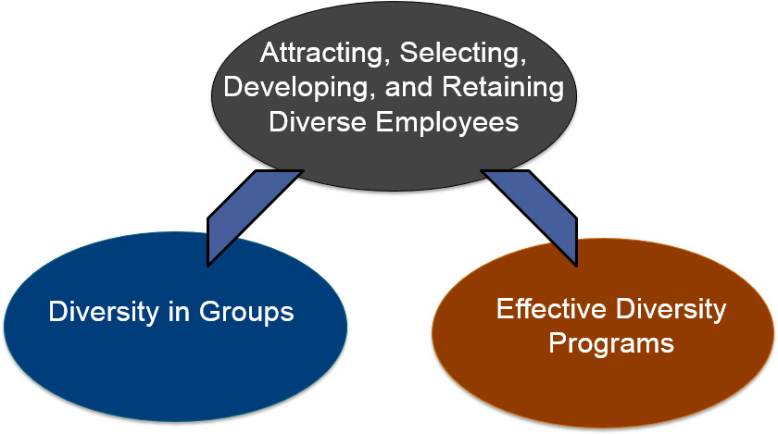
Describe How Organizations Manage Diversity Effectively (2 of 6)
Notes:
Managing diversity effectively begins by attracting, selecting, developing, and retaining employees who can operate and excel in a workplace with diverse individuals, viewpoints, and ideas. These efforts are then complemented by effectively managing diversity in groups and ensuring that strong diversity programs are in place.

Slide 25
Describe How Organizations Manage Diversity Effectively (3 of 6)
Attracting, selecting, developing, and retaining diverse employees
Target recruiting messages to specific demographic groups.
Some companies have been actively working toward recruiting less-hired groups.
Notes:
Attracting, selecting, developing, and retaining diverse employees are important to the process. Recruiting messages should be targeted to specific demographic groups that are underrepresented in the workforce.

Slide 26
Describe How Organizations Manage Diversity Effectively (4 of 6)
Diversity in Groups
Most people in groups need a common way of looking at and accomplishing major tasks, and they need to communicate well with each other.
Emphasize higher-level similarities among people.
Notes:
Working in group settings is common in most contemporary workplaces. To be effective members of a group, employees need a common way of looking at and accomplishing major tasks, as well as good communication skills. Emphasizing higher-level similarities can also increase the effectiveness of groups.

Slide 27
Describe How Organizations Manage Diversity Effectively (5 of 6)
Expatriate Adjustment
Organizations should select employees for international assignments who are capable of adjusting quickly and ensure they have the support they need for their assignment.
Notes:
Several factors should be targeted to help the adjustment process for expatriates.
Feelings of empowerment along with the motivation to interact with those of other cultures were found in to be related to adjustment, satisfaction, and reduced intentions to leave prematurely.
Those with previous culture-specific work experience as well as higher self-esteem and self-efficacy tend to adjust and be promoted more quickly.
Several other factors work in concert to affect different forms of adjustment, including language ability, relational skills, role clarity and autonomy, organizational support, and familial support.

